Slide 1
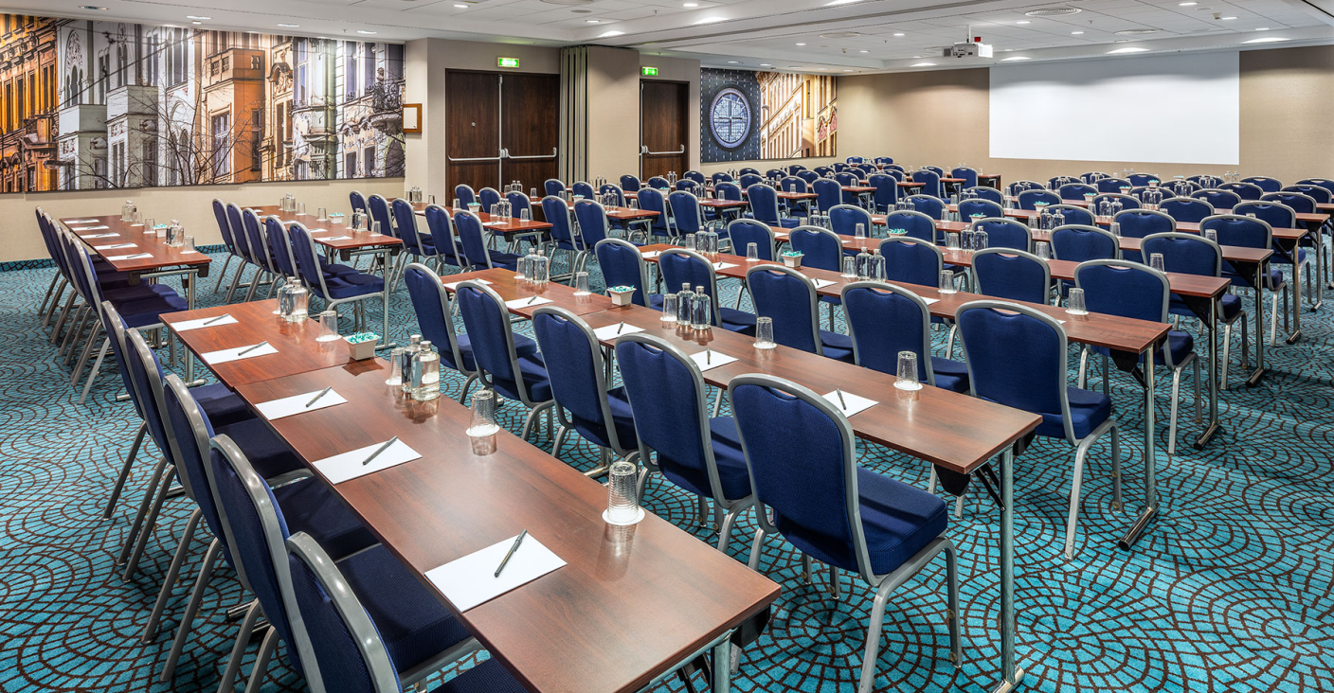
COURTYARD BY MARRIOTT PRAGUE CITY
Hotel information

Slide 2
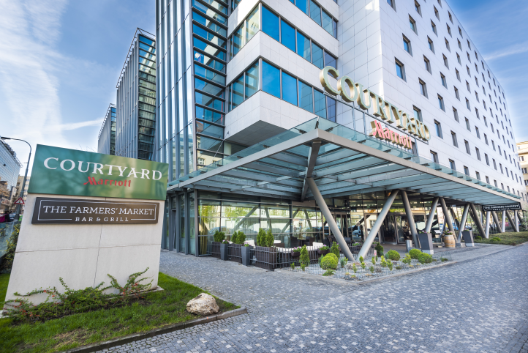
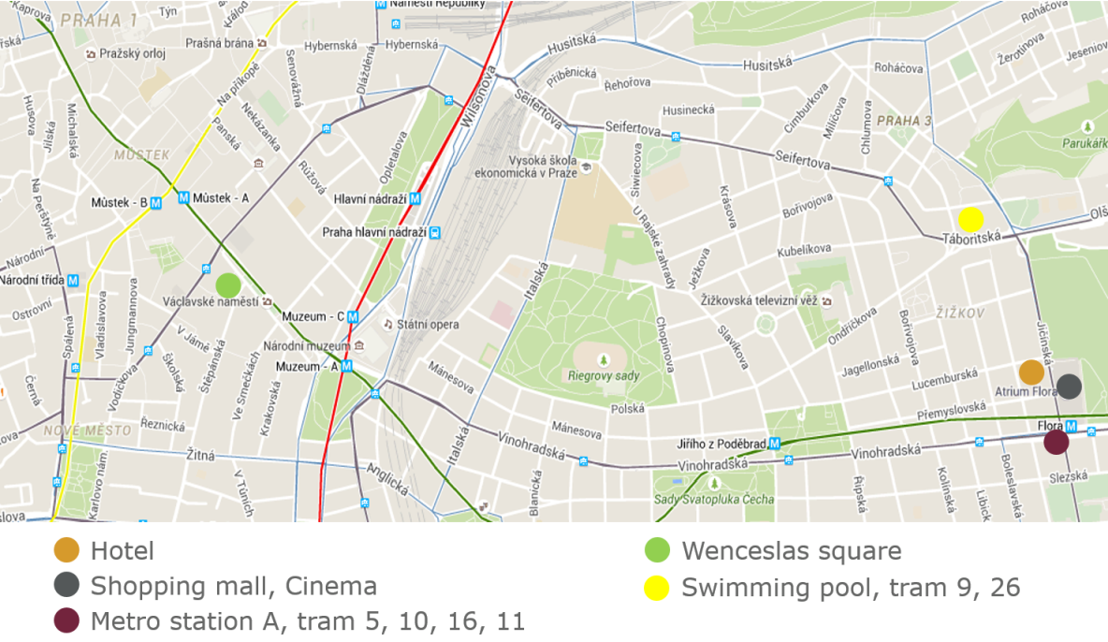
Hotel Information
Hotel is located in between two upbeat districts of Prague – Vinohrady and Žižkov – just opposite the Atrium Flora Shopping Mall
30 minutes by car to the airport, 7 minutes by public transport to the city center
161 rooms across 8 floors
4 flexible conference rooms located on the ground floor, 2 conference rooms with day light + 1 with indirect day light
Additional break-out rooms for up to 12 persons (33m²) can be converted from Family rooms
Business corner in the lobby – internet connection, complimentary printing facilities
The Farmers’ Market Bar & Grill restaurant offering modern local cousine and the world´s famous Czech beer
The Market – minimarket (open 24/7) with a wide range of products
Summer terrace in front of the hotel with comfortable lounge seating
Gym (open 24/7) located on the ground floor with day-light
Underground garage parking (monitored 24/7)
Free Wi-Fi Connection
Location

Slide 3
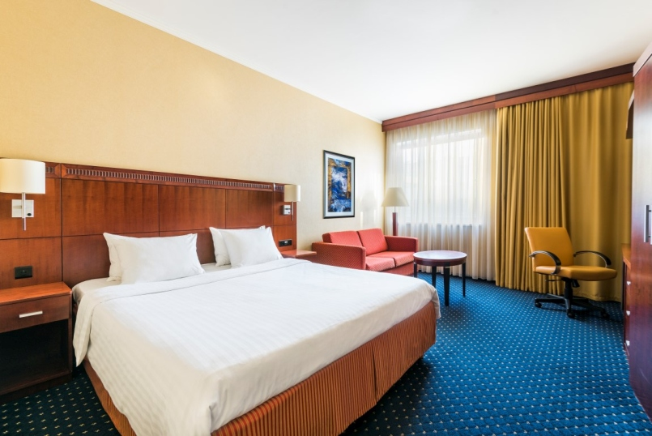
Accommodation
Check in | 01.10.2019
Check out | 03.10.2019
Number of rooms | 20
Number of nights | 2
Room category | Quality room
Price | 3,150 CZK for single room per night
Price | 3,310 CZK for double room per night
Pokoj Deluxe King
Price is quoted per room per night, including breakfast buffet, standard internet connection and access to the gym. Price does not include VAT 15 % and city tax (city tax is newly applicable for groups arriving as of 1st January 2020).
Gratuity
For every 40 room nights, 1 room night complimentary
Rooms amenities
*Coffee and tea station
*Fridge
*Safe
*Iron and ironing board
*Satellite TV
*Air-conditioning
*Hair dryer
*Wi-Fi

Slide 4
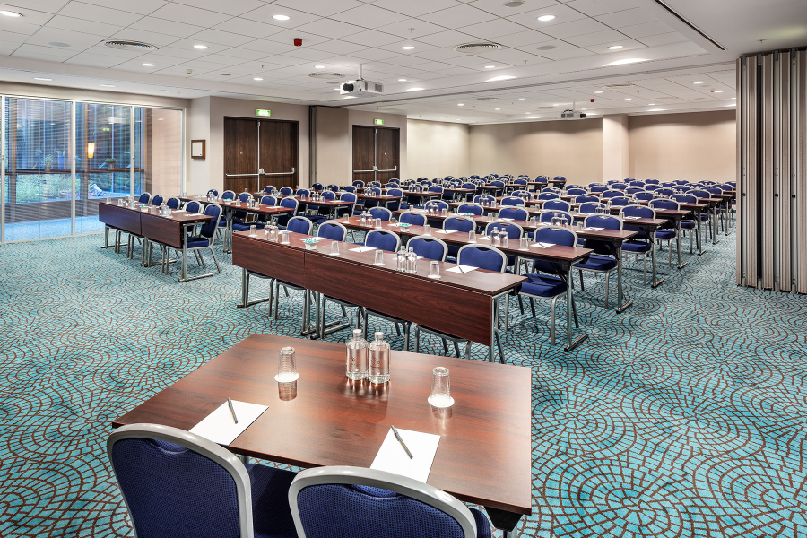
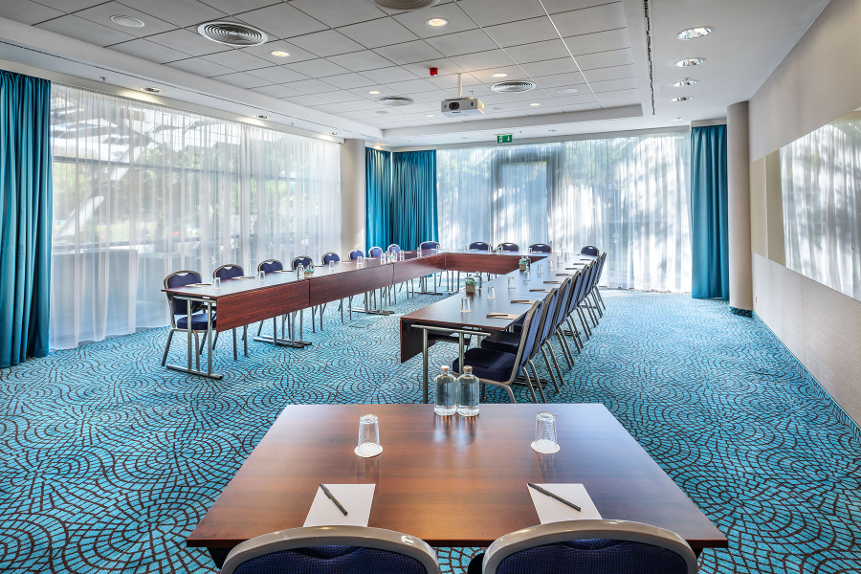
Conference
Date | 28. – 30.06.2019
Function room | Vinohrady I+II
Time | Full-day / Half-day
Set-up | U-Shape
Number of delegates | 25
Courtyard Prague city is delighted to offer our conference packages that will suit your needs the best:
Price:
1,695 CZK per person and day incl. VAT and 10 % service charge
1,495 CZK per person and half day incl. VAT and 10 % service charge
Vinohrady I+II
Conference package includes:
*Half-day/Full-day conference room rental
*Projector and screen
*Flipchart and markers
*Morning and/or afternoon coffee break
*Business lunch buffet including one non-alcoholic beverage and coffee or tea
*Unlimited water service in conference room
*Internet access
*Notepads, pens, mints
*VAT
*Service charge
Žižkov

Slide 5
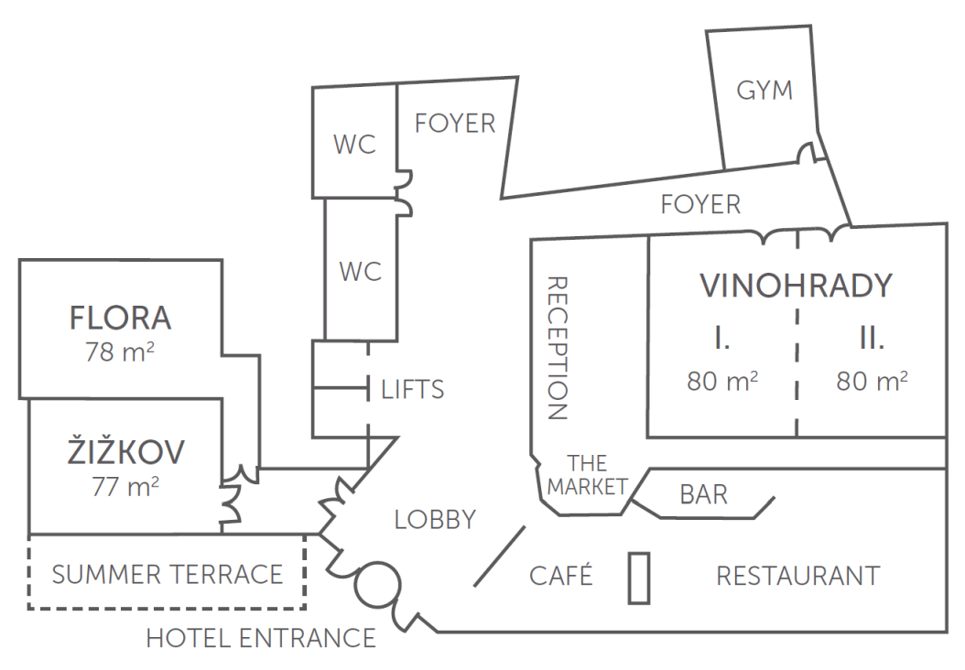
Conference
Meeting room | Dimension (m) | Area (m2/ft2) | Theater | Classroom Table 75 cm | Classroom Table 45 cm | Boardroom / Hollow Square | U-shape | Cabaret | Lunch & Dinner
Žižkov | 7.5 x 10.2 x 3.4 | 77 / 818 | 84 | 40 | 50 | 28 | 26 | 36 | 40
Flora | 7.4 x 10.6 x 3.4 | 78 / 840 | 98 | 52 | 60 | 34 | 30 | 36 | 40
Vinohrady I | 7.7 x 10.4 x 3.4 | 80 / 861 | 91 | 40 | 50 | 30 | 27 | 36 | 60
Vinohrady II | 7.7 x 10.4 x 3.4 | 80 / 861 | 91 | 40 | 50 | 32 | 27 | 36 | 60
Vinohrady I & II | 10.4 x 15.4 x 3.4 | 160 / 1722 | 182 | 70 | 100 | 52 | 43 | 72 | 120

Slide 6
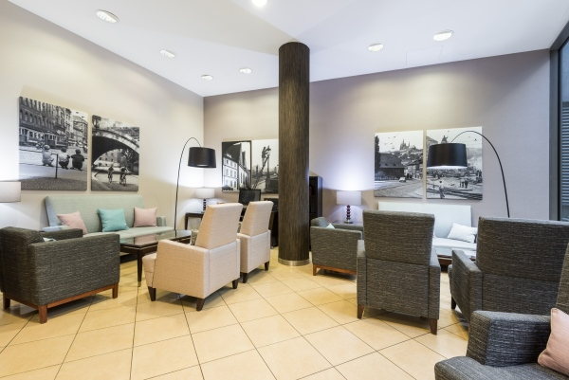



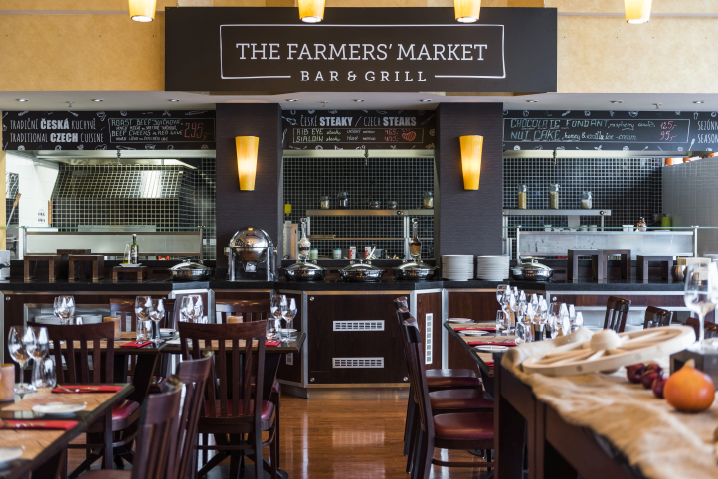

Option
This reservation is held on a shared option basis until 01.07.2019. After this date we are not able to guarantee availability and rates.
COMISSION
10 % from net room, DDR and F&B rates, excluding VAT and service charge. Commission is paid based on final numbers.
courtyardpraguecity.com
CourtyardPragueCity
courtyardpraguecity
See TripAdvisor reviews that our location is really convenient
Contact person
Stepan Zak – Director of EBC, Courtyard by Marriott Prague City
Stepan.Zak@marriott.com, Tel: +420 222 881 032
Lobby
The Farmers’ Market Bar & Grill

Slide 7


ENSURE YOUR EVENTS’ SUCCESS
Make the most of meetings and events with Marriott Bonvoy™ Events.
Work with skilled professionals and state-of-the-art technologies that ensure your events’ success. Earn Marriott Bonvoy™ points for eligible meetings and events you plan at any of our participating brands’ hotels and resorts.*
Then redeem the points you’ve earned for Free Night Awards at any of our more than 6,900 Marriott Bonvoy hotels around the world, once-in-a-lifetime experiences with Marriott Bonvoy™ Moments and more.
EARN MORE
Book 10 rooms or more for at least one night or a catered-only event, such as a meeting, reception, banquet, wedding or reunion, and you’ll earn 2 points for every US$1 spent on all eligible charges, including rooms, food and beverage, audiovisual charges, and more.
ACHIEVE ELITE STATUS
Earn more as you achieve Elite status. For each qualifying event, most Marriott Bonvoy Members can earn up to 60,000 points (2 points per US$1), while Marriott Bonvoy Titanium Elite and Ambassador Elite members can earn up to 105,000 points per qualifying event.
Earn 10 Elite Night Credits for your first event and one Elite Night Credit for every 20 room nights you book after that — up to a maximum of 20 Elite Night Credits per contract. The Elite Night Credits you earn add up to help you achieve Elite status.
See how many Elite Night Credits are needed to achieve each status level at marriottbonvoy.com/terms.
GET READY TO REDEEM
Discover the endless possibilities with Marriott Bonvoy. We have many ways for you to redeem your points, including:
Free Night Awards at more than 6,900 Marriott Bonvoy hotels.
Once-in-a-lifetime experiences from Marriott Bonvoy Moments.
Gift cards to use toward personal travel or your next meeting or event.
BE REWARDED
Step up your earning potential with our co-brand credit card at marriott.com/loyalty/earn/credit-card-rewards.mi.
Learn more about Marriott Bonvoy Events and enroll at marriottbonvoy.com/events.
CALCULATE YOUR POINTS
Excited? You can calculate the approximate points for your event: http://marriottbonvoyeventscalculator.dja.com/

Slide 8
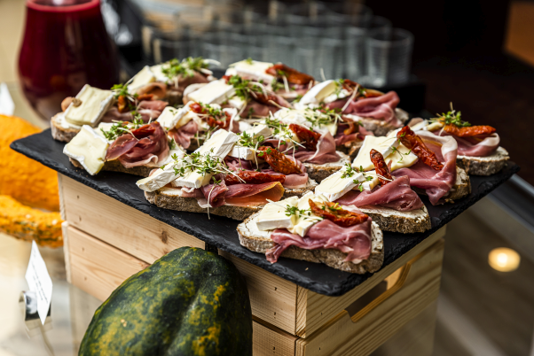
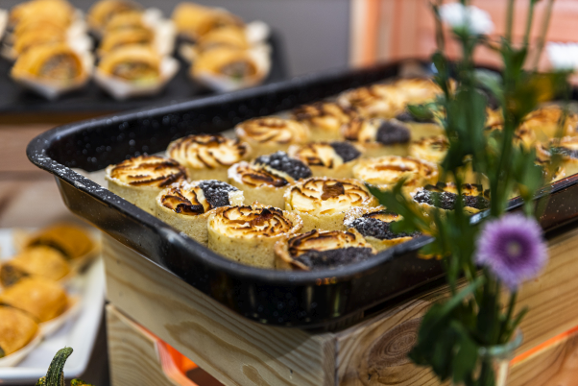
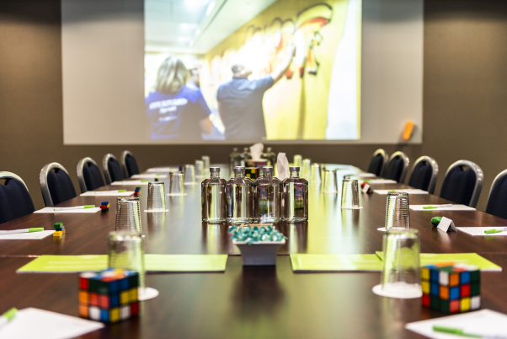
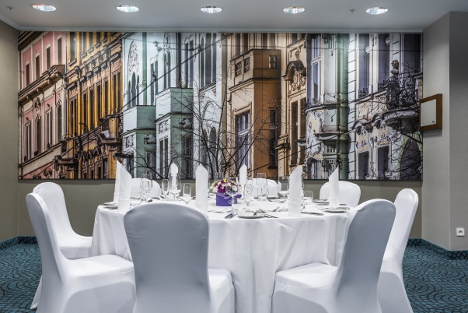
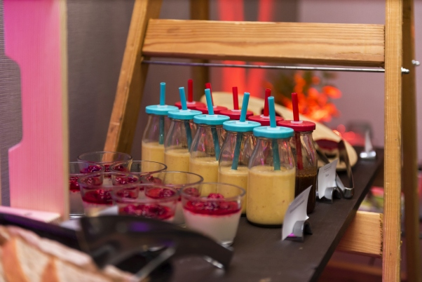
PASSION MOVES US FORWARD
Your attendees expect a meeting experience that leaves them feeling connected, inspired and accomplished. That’s why Marriott starts with people – their business purpose, the way they work and the technology they use.
Explore all options with us!

